Slide 1
Book: Head First
Chapter-7:
Better Living in Objectville
Upcode Software
Engineer Team
-2023-

Slide 2
CONTENT
Java Memory Model
What is OOP ?
Why Understanding Inheritance ?
Using IS-A and HAS-A?
What is a polymorphism ?
Summary

Slide 3
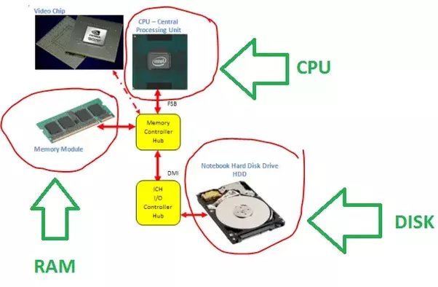
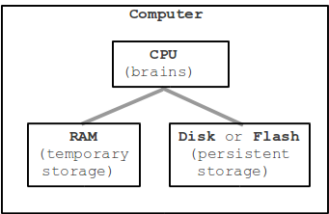
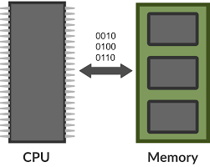
The Internal Java Memory Model(1/n)
CPU percentage: to show how much percentage of processor is being used.
Memory percentage: to show how much percentage of inside memory (RAM) is being used.
Disk percentage: to show how much percentage of storage (HDD, SSD) is being used.

Slide 4
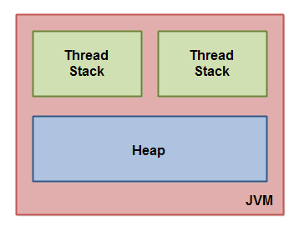
The Internal Java Memory Model(2/n)
The Java memory model used internally in the JVM divides memory between thread stacks and the heap
Each thread running in the Java virtual machine has its own thread stack.
The thread stack contains information about what methods the thread has called to reach the current point of execution.

Slide 5
The Internal Java Memory Model(3/n)
The heap contains all objects created in your Java application, regardless of what thread created the object.
This includes the object versions of the primitive types (e.g. Byte, Integer, Long etc.).
It does not matter if an object was created and assigned to a local variable, or created as a member variable of another object, the object is still stored on the heap.

Slide 6
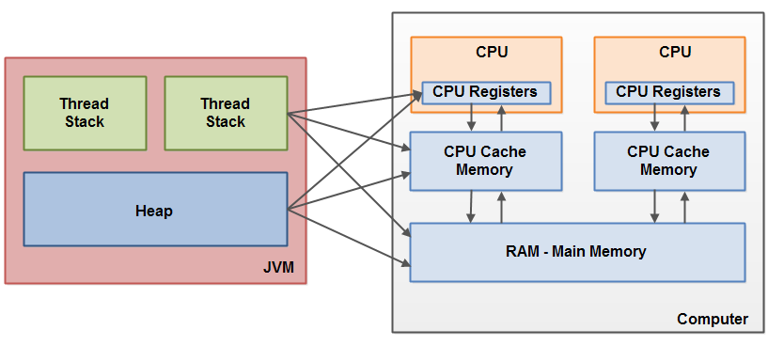
The Internal Java Memory Model(4/n)
The thread stack also contains all local variables for each method being executed (all methods on the call stack).
A thread can only access it's own thread stack.
Local variables created by a thread are invisible to all other threads than the thread who created it.\
Even if two threads are executing the exact same code, the two threads will still create the local variables of that code in each their own thread stack.
Each thread has its own version of each local variable.

Slide 7
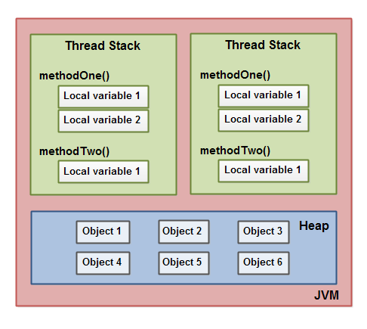
The Internal Java Memory Model(4/n)
All local variables of primitive types ( boolean, byte, short, char, int, long, float, double) are fully stored on the thread stack and are thus not visible to other threads.
One thread may pass a copy of a primitive variable to another thread, but it cannot share the primitive local variable itself.
The heap contains all objects created in your Java application, regardless of what thread created the object.

Slide 8
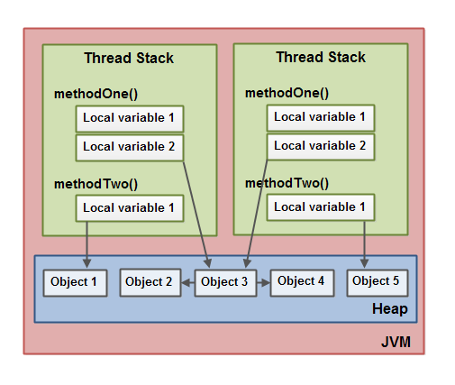
The Internal Java Memory Model(5/n)
This includes the object versions of the primitive types (e.g. Byte, Integer, Long etc.). It does not matter if an object was created and assigned to a local variable, or created as a member variable of another object, the object is still stored on the heap.
A local variable may also be a reference to an object. In that case the reference (the local variable) is stored on the thread stack, but the object itself if stored on the heap.
An object may contain methods and these methods may contain local variables. These local variables are also stored on the thread stack, even if the object the method belongs to is stored on the heap.

Slide 9
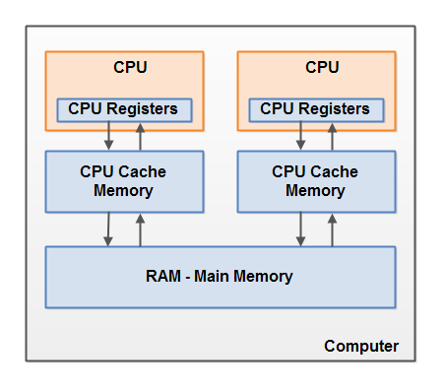
The Internal Java Memory Model(6/n)
Some of these CPUs may have multiple cores.
The point is, that on a modern computer with 2 or more CPUs it is possible to have more than one thread running simultaneously.
Each CPU is capable of running one thread at any given time. That means that if your Java application is multithreaded, one thread per CPU may be running simultaneously (concurrently) inside your Java application.

Slide 10
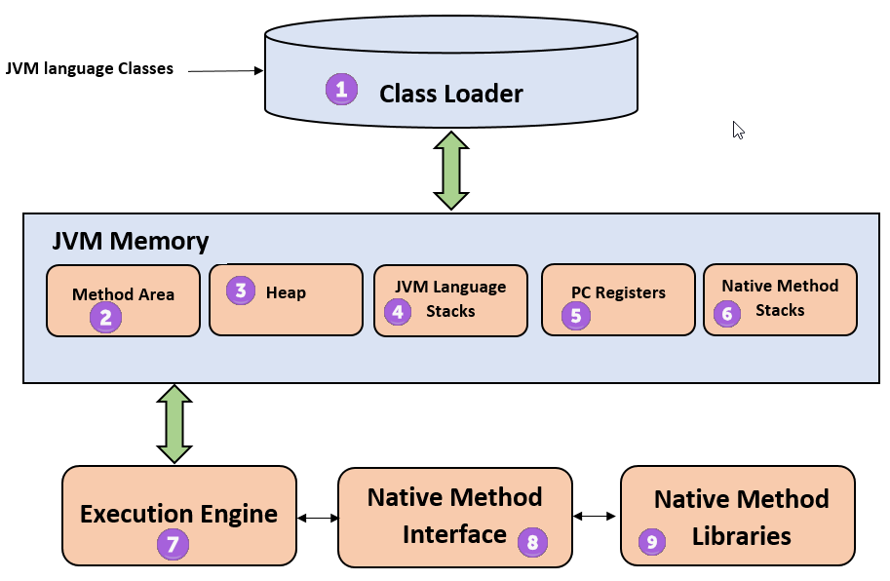
The Internal Java Memory Model(7/n)

Slide 11
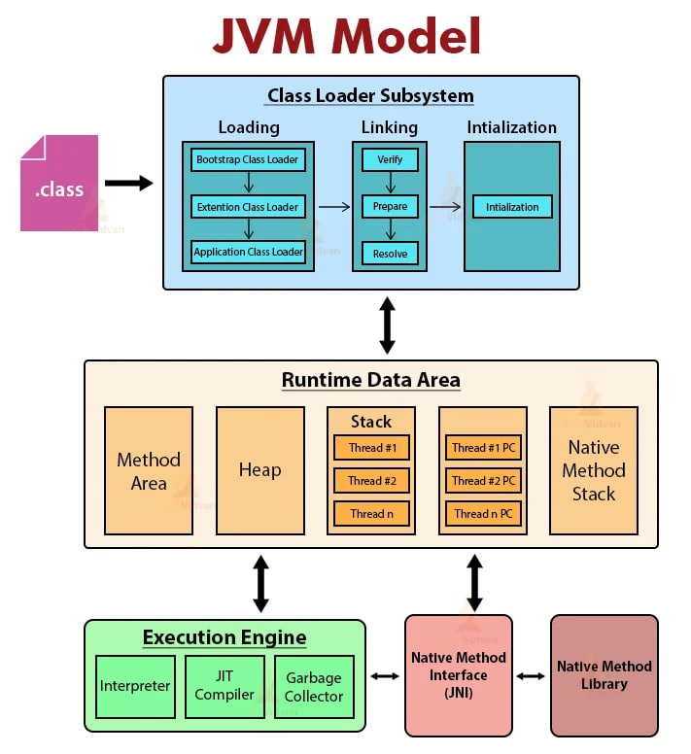
The Internal Java Memory Model(8/n)
1

Slide 12
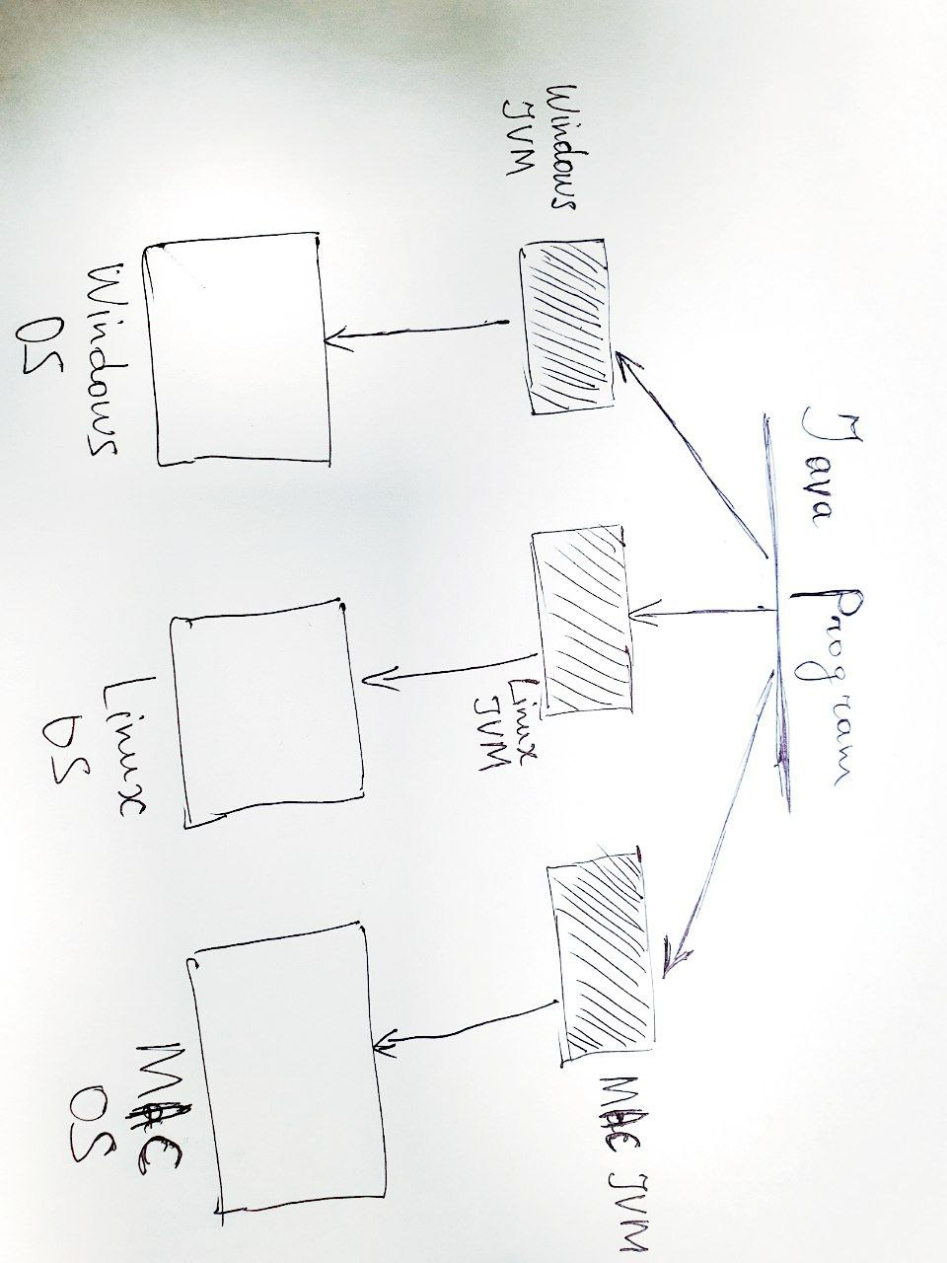
The Internal Java Memory Model(9/n)

Slide 13
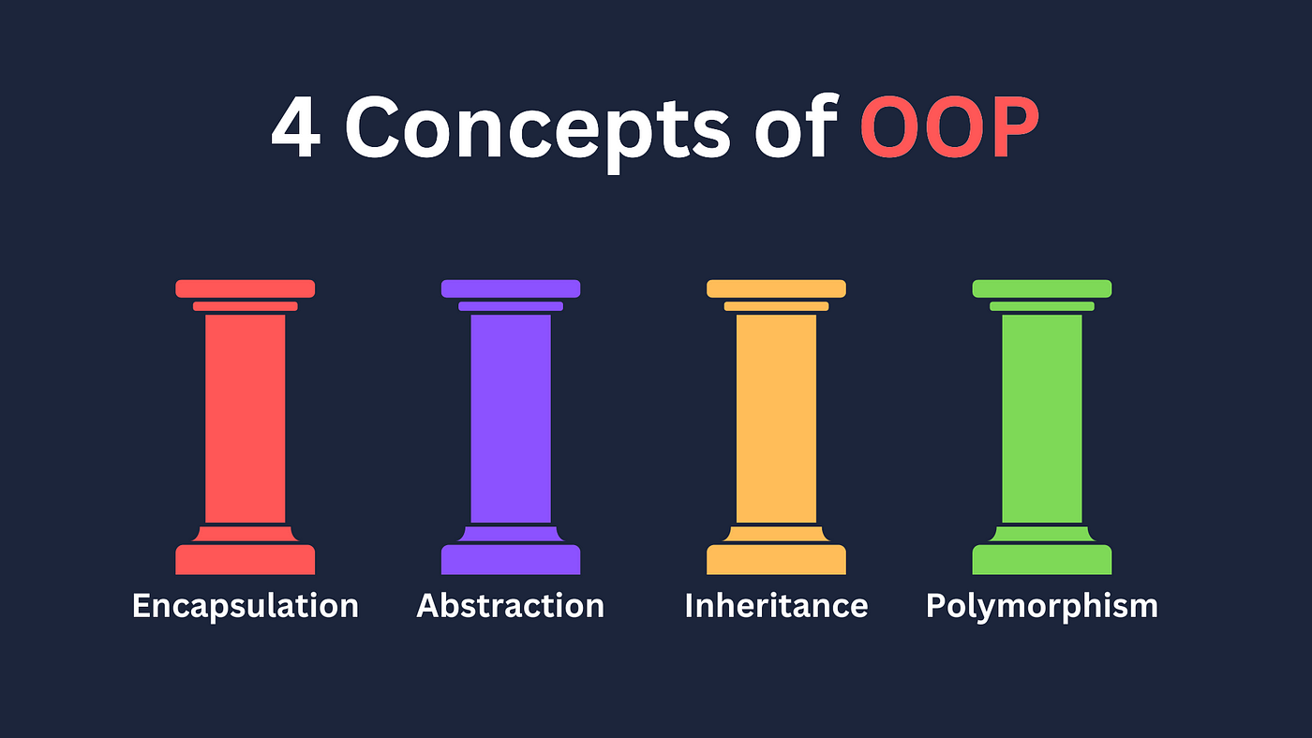
What is OOP?
Start today, and we’ll throw in an extra level of abstraction!
Object-oriented programming (OOP) is a computer programming model that organizes software design around data, or objects, rather than functions and logic.

Slide 14
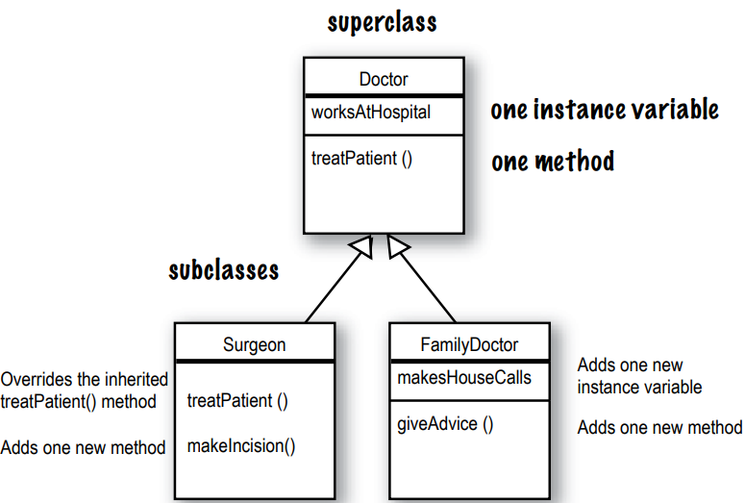
What is the power of inheritance ?
Instance variables are not overridden because they don’t need to be.
They don’t define any special behavior, so a subclass can give an inherited instance variable any value it chooses

Slide 15
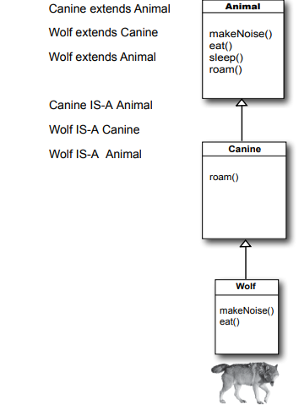
Using IS-A and HAS-A?
Remember that when one class inherits from another, we say that the subclass extends the superclass.
When you want to know if one thing should extend another, apply the IS-A test.
If class B extends class A, class B IS-A class A. This is true anywhere in the inheritance tree. If class C extends class B, class C passes the IS-A test for both B and A.

Slide 16
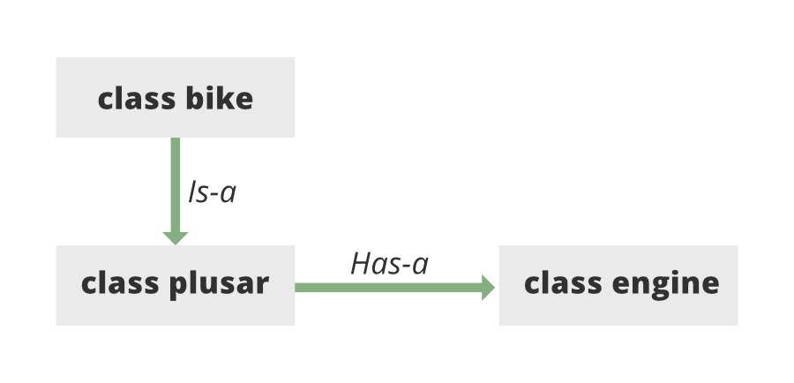
Using IS-A and HAS-A?

Slide 17
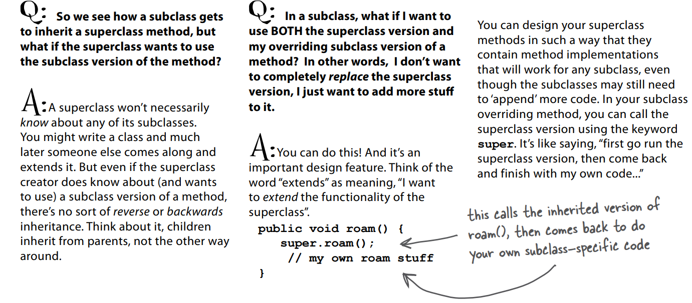
Q&A

Slide 18
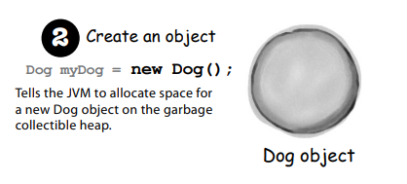
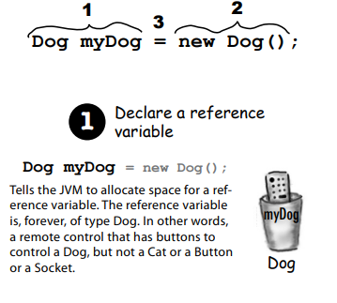
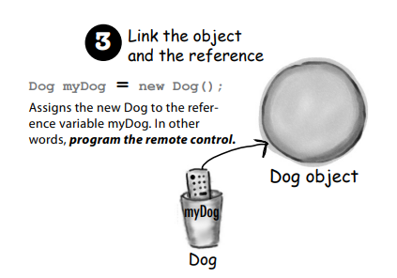
What is a polymorphism ?
how polymorphism works, we have to step back and look at the way we normally declare a reference and create an object...
The 3 steps of object declaration and assignment

Slide 19
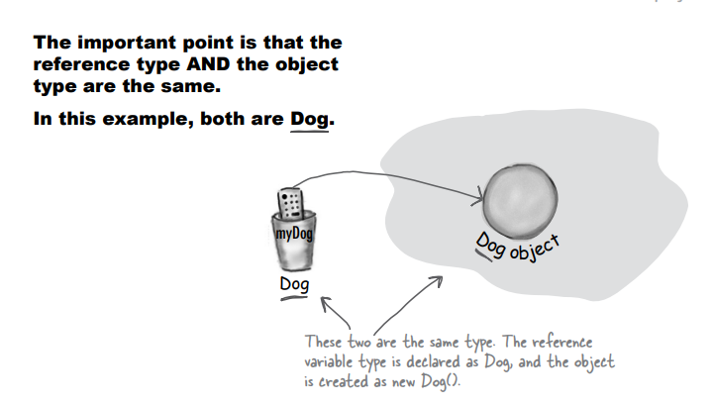
What is a polymorphism ?

Slide 20
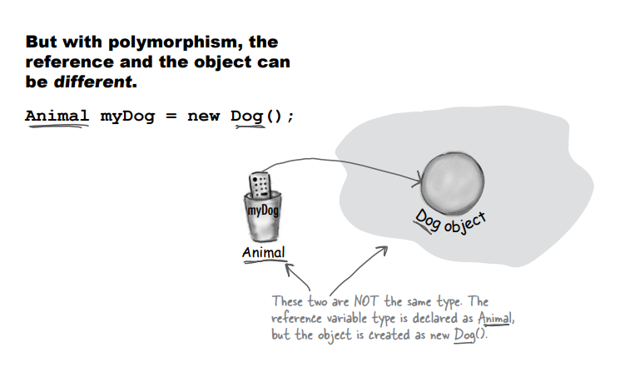
What is a polymorphism ?

Slide 21

Q&A

Slide 22
Summary
Keep in mind that the inheritance IS-A relationship works in only one direction!
With polymorphism, the reference type can be a superclass of the actual object type

Slide 23
Reference Resources?
Head First (book)
Java Memory Management
Resource Java Memory

Slide 24
Thank you!
Presented by
Hamdamboy Urunov
(hamdamboy.urunov@gmail.com)

